Slide 2
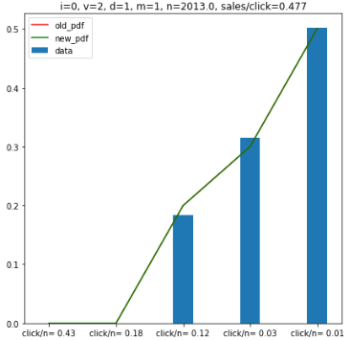
The dangers of “one-target” bidding
One target: assume all 5
P(c|r=5)*n=0.02015*2013 = 40.6 clicks
True # of clicks=107
PDF targets: assume different rank
P(r=5)* P(c|r=5)*n=.5*0.02015*2013 = 20.3 clicks
P(r=4)* P(c|r=4)*n=.3*0.041203*2013 = 24.9 clicks
P(r=3)* P(c|r=3)*n=.2*0.151822*2013 = 61.1 clicks
total= 106.3 clicks

Slide 3
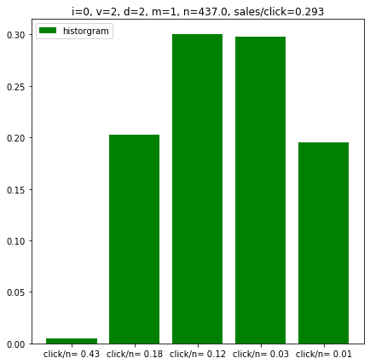
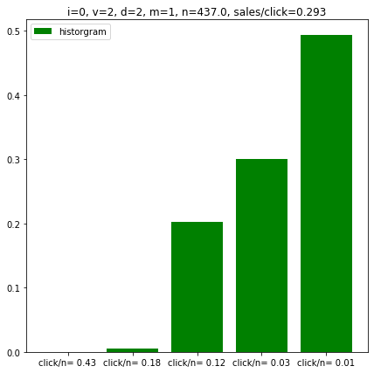
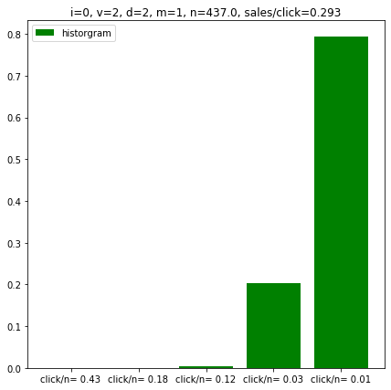
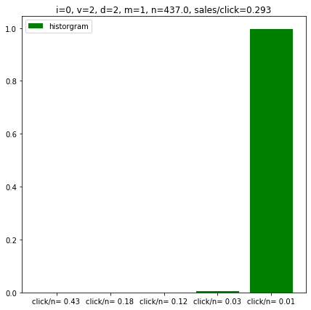
A way to approximate cost (type=14)
No mean shift
cost: $10
1 shift down
2 shifts down
3 shifts down
cost: $1
For this case: cost/shift ~=($10-$1)/3=$3
No model is accurate, some models are helpful

Slide 4
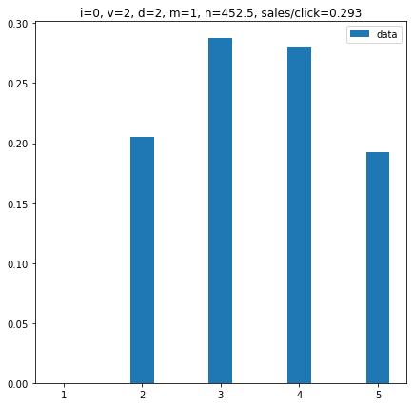
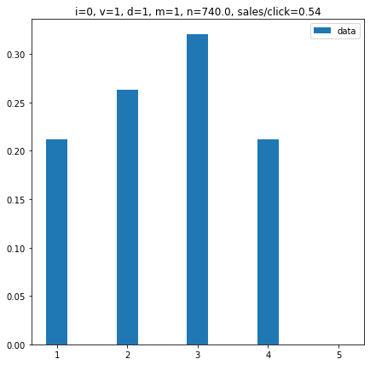

How we bid
Bid decrease per shift is $3.00
Bid increase per shift is $2.25
Sales/Click=.26
Combining both gives
Sales/Click=.59
13 sales
$460
7 sales
$171
13 sales
$308
8 sales
$156
$137 Saved
What if it isn’t this obvious which way we should shift?
Wait until all the “low hanging fruit” is gone
See if we need an increase in sales or decrease in cost
Test a fractional cost movement for all 16 types
Choose the movement with the lowest cost/sale

Slide 5
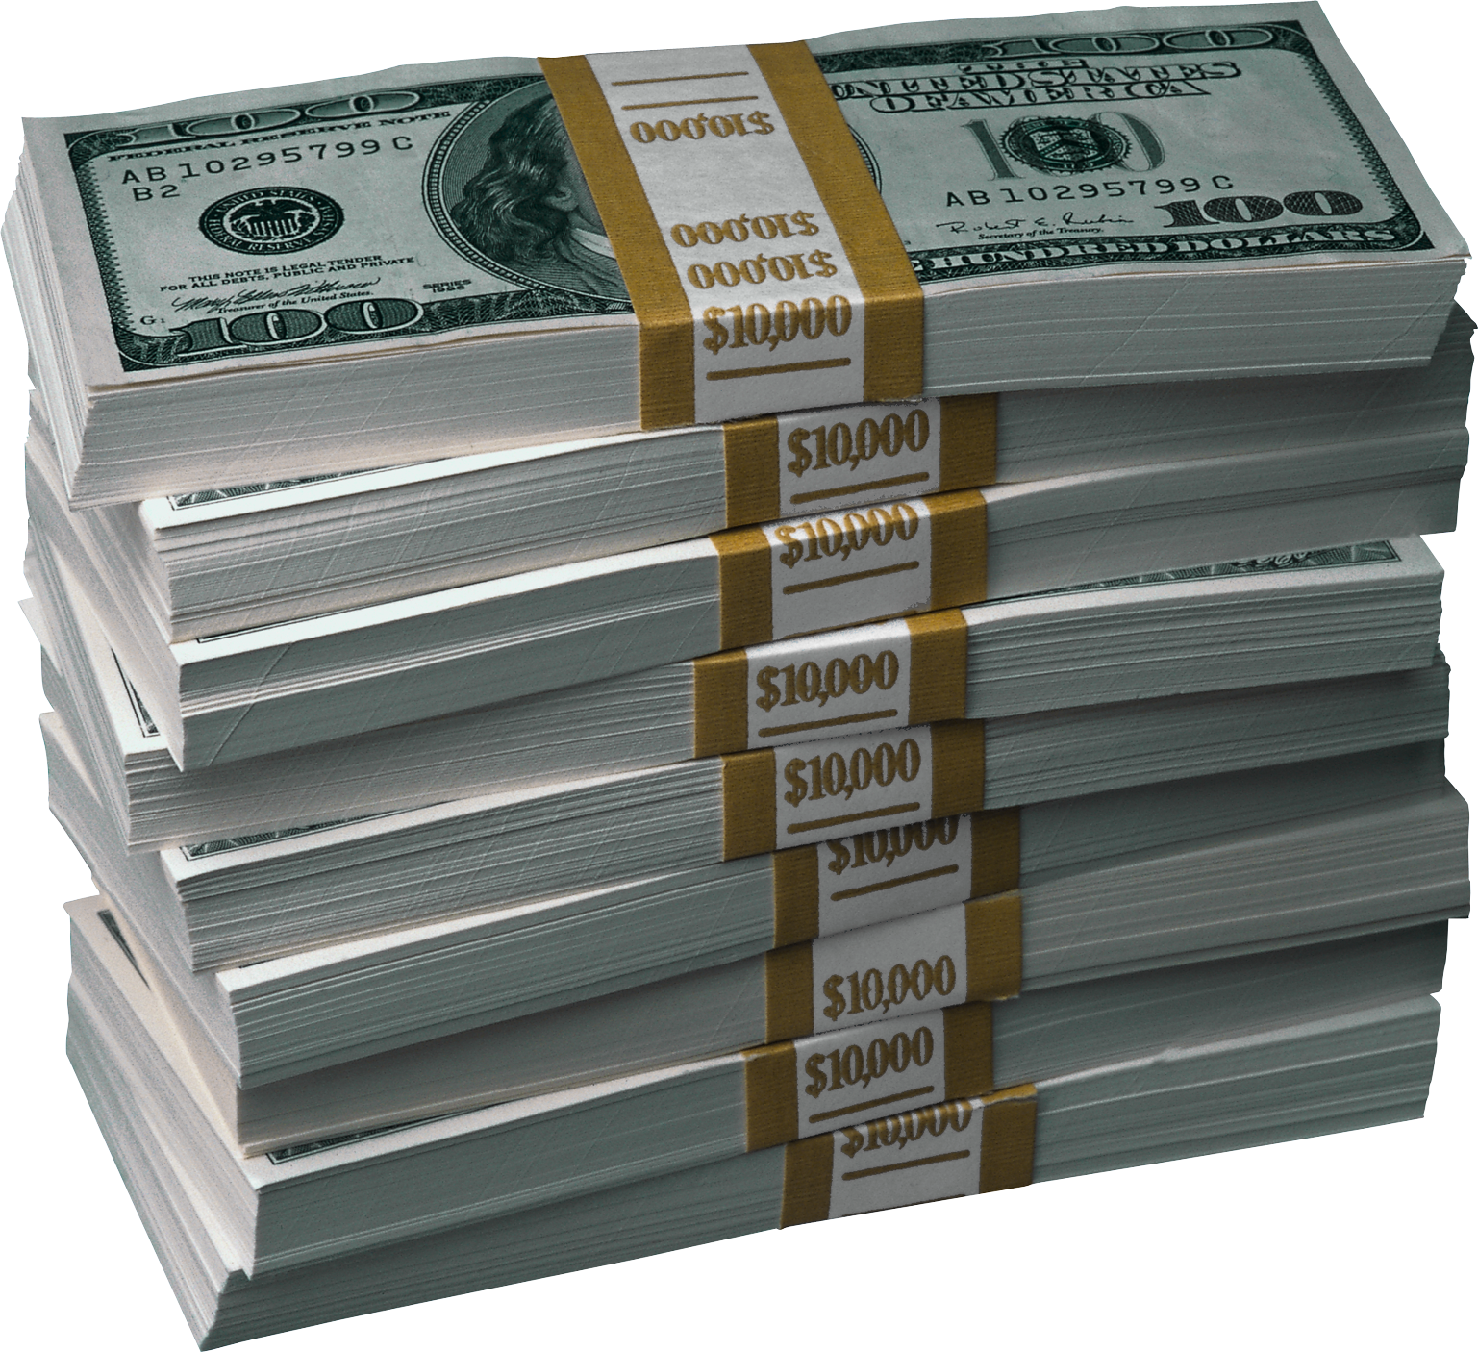
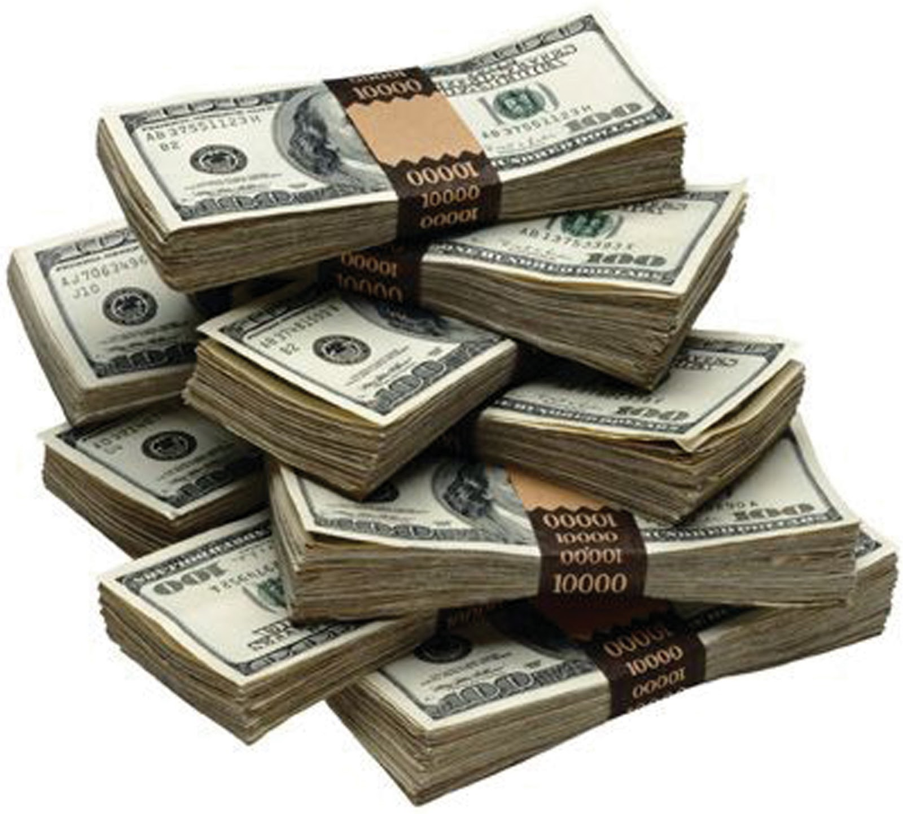
SHOW ME THE MONEY!!!
 | Original | Big Savings | Same Sales | Big Sales
Sales | 545 | 400 | 545 | 590
Cost | $13,740 | $7,620 ($6,120 saved) | $12,101 ($1,639 saved) | $13,740
$/Sale | $25.21 | $19.05 | $22.20 | $23.27

